Slide 1
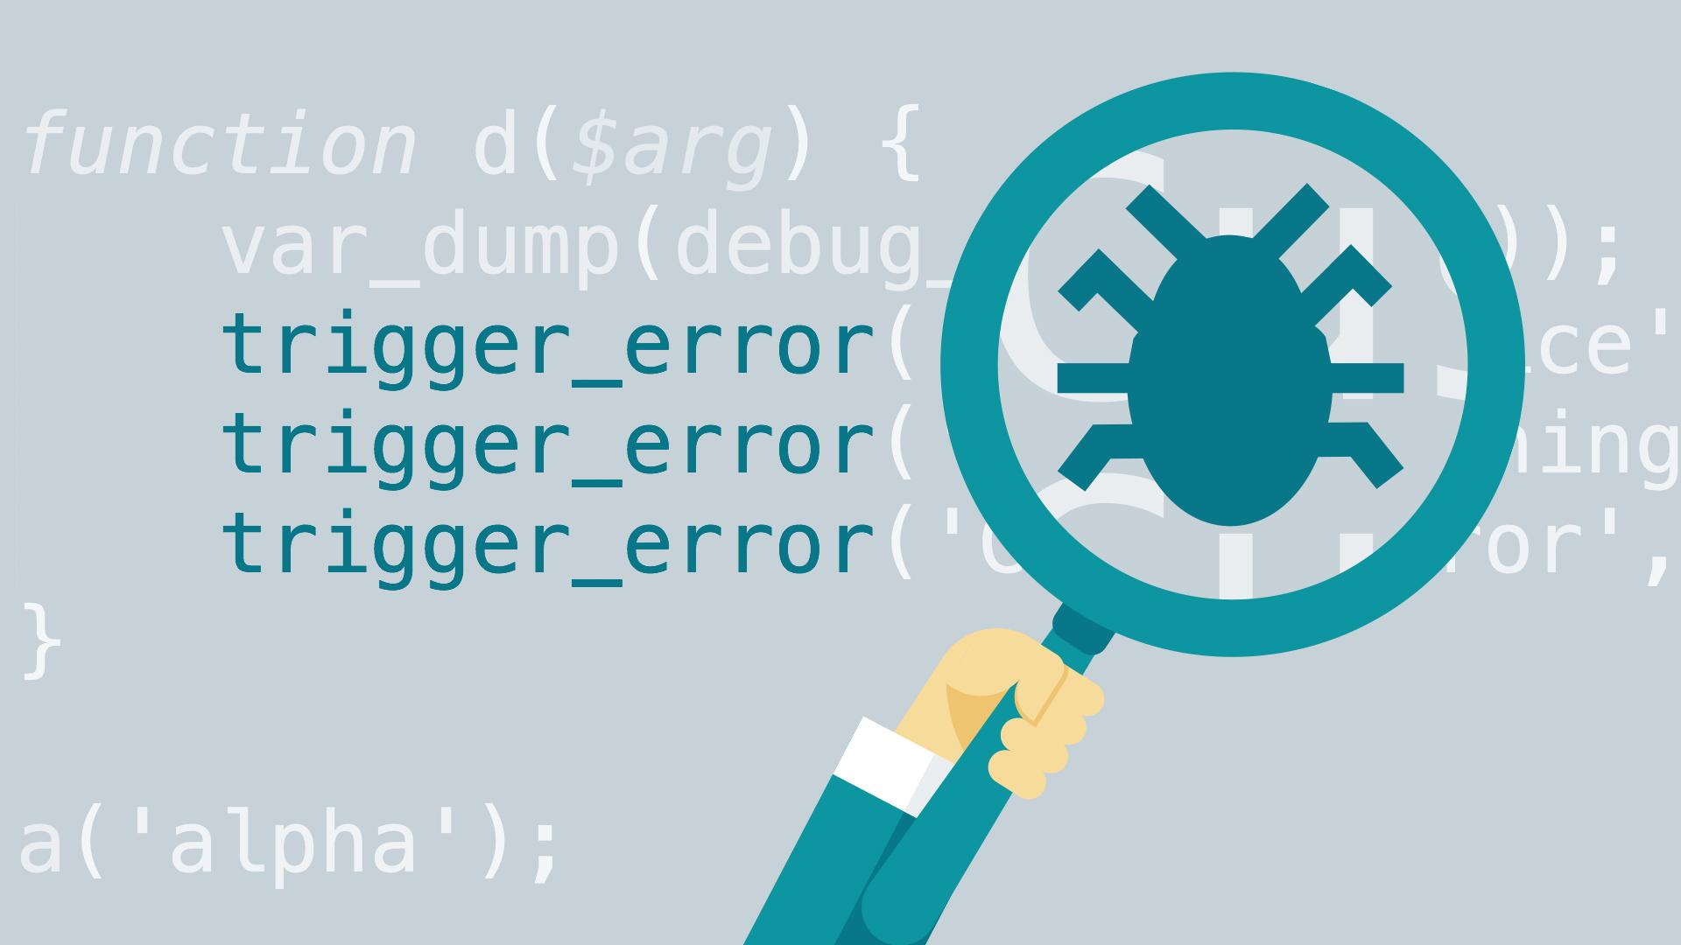
Progress Report Debugging
SEEGENE AI DIAGNOSTIC PATHOLOGY PROJECT
KIRC-KAIST
30th of APR
Notes:
Image source: https://www.lynda.com/PHP-tutorials/Debugging-PHP-Advanced-Techniques/112414-2.html

Slide 2
Progress

Slide 3
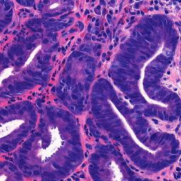
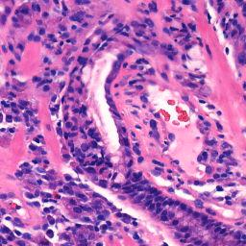
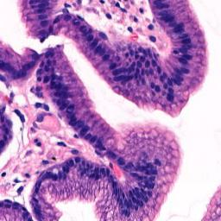
Data Inconsistency Different Zoom Level Different Slide Dimension
Stain Normalization

Slide 4
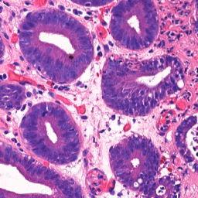
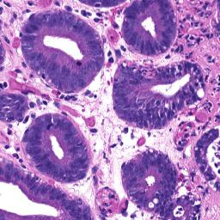
Stain Normalization
Notes:
Image Source: https://www.executivewarcollege.com/wp-content/uploads/McClintock.THUR_.8.10am.FINAL_.pdf

Slide 5

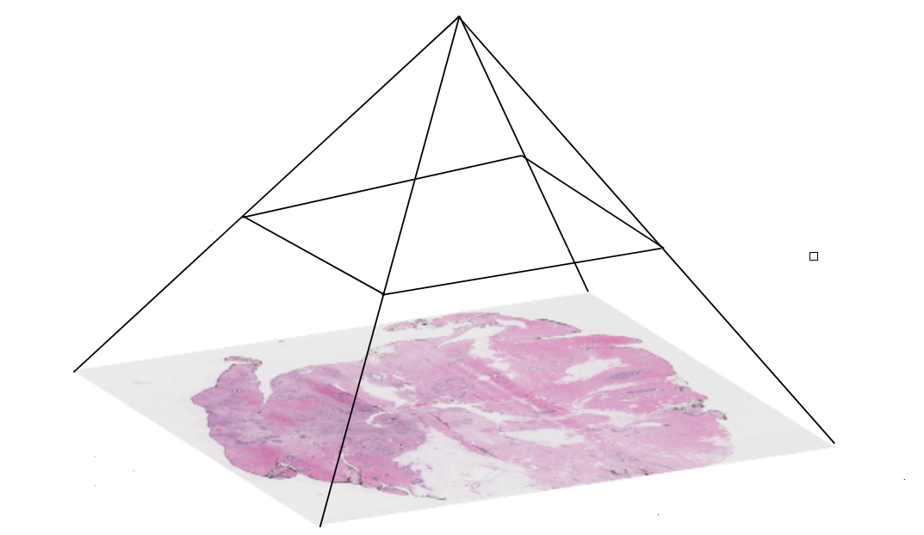
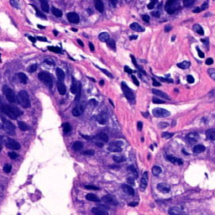
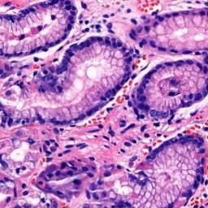
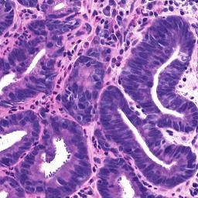
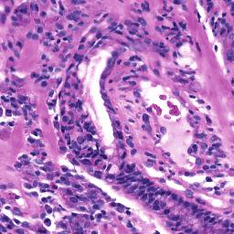
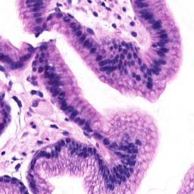
18
19
STAIN NORMALIZATION 3x more time
91200
212640
90036
202456
Library: https://hackmd.io/@peter554/staintools

Slide 6
Hard Cases Predictions

Slide 7
SLIDE | GROUND TRUTH | Not Normalized |  |  | Normalized
Hard Cases |  | D | M | N | D | M | N
2021S 0061244010103 | D | 62 | 18 | 1830 | 85 | 9 | 1816
2021S 0061365020101 | D | 17 | 50 | 536 | 27 | 16 | 560
2021S 0067741010101 | D | 168 | 10 | 744 | 135 | 1 | 786
2021S 0085210020102 | M | 0 | 2 | 586 | 3 | 10 | 575
2021S 0079483010101 | M | 1 | 12 | 348 | 9 | 5 | 347
2021S 0080797020101 | M | 0 | 8 | 247 | 0 | 3 | 252
2020S 0371642010101 | N | 9 | 4 | 271 | 7 | 0 | 277
2020S 0371904010101 | N | 0 | 12 | 409 | 0 | 14 | 407
2021S 0069196010103 | N | 0 | 13 | 100 | 0 | 1 | 112

Slide 8
Findings

Slide 9
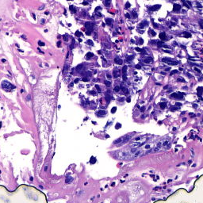

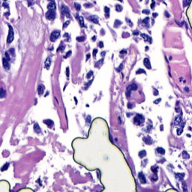
Not Normalized Stain Normalized
N
N
99%
90%
N
N
98%
74%
Malignant 2021S 0080797020101

Slide 10
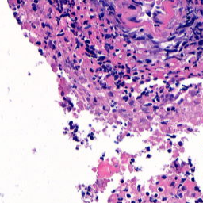
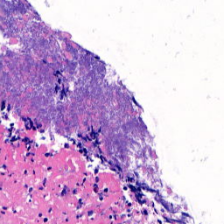
Not Normalized Stain Normalized
N
M
67%
99%
N
M
74%
99%
Normal 2021S 0069196010103

Slide 11
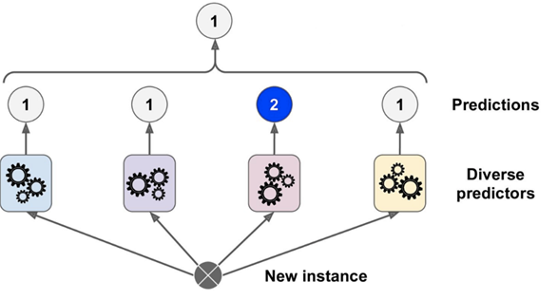
Cross Matching, Confidence Scoring, Majority Voting, Average …

Slide 12
To Do

Slide 13
To Do
Train model for colon data with and without normalization.
Investigate ensemble network for removing adversarial attack.
Train slide level models with updated patch based models.

Slide 14
Thanks

